Slide 1
A Vision for an AI-Savvy Library Community
Vessela Ensberg
Associate Director for Product & Strategy

Slide 2
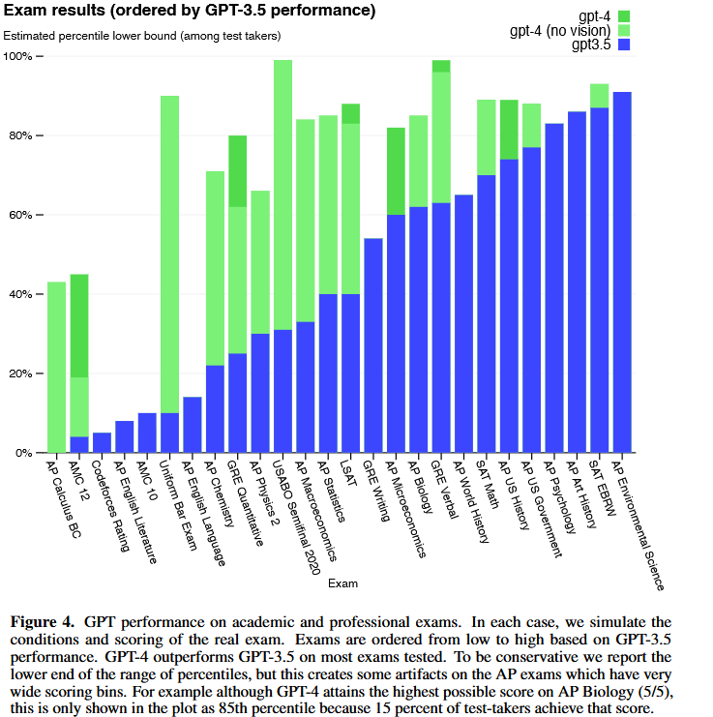
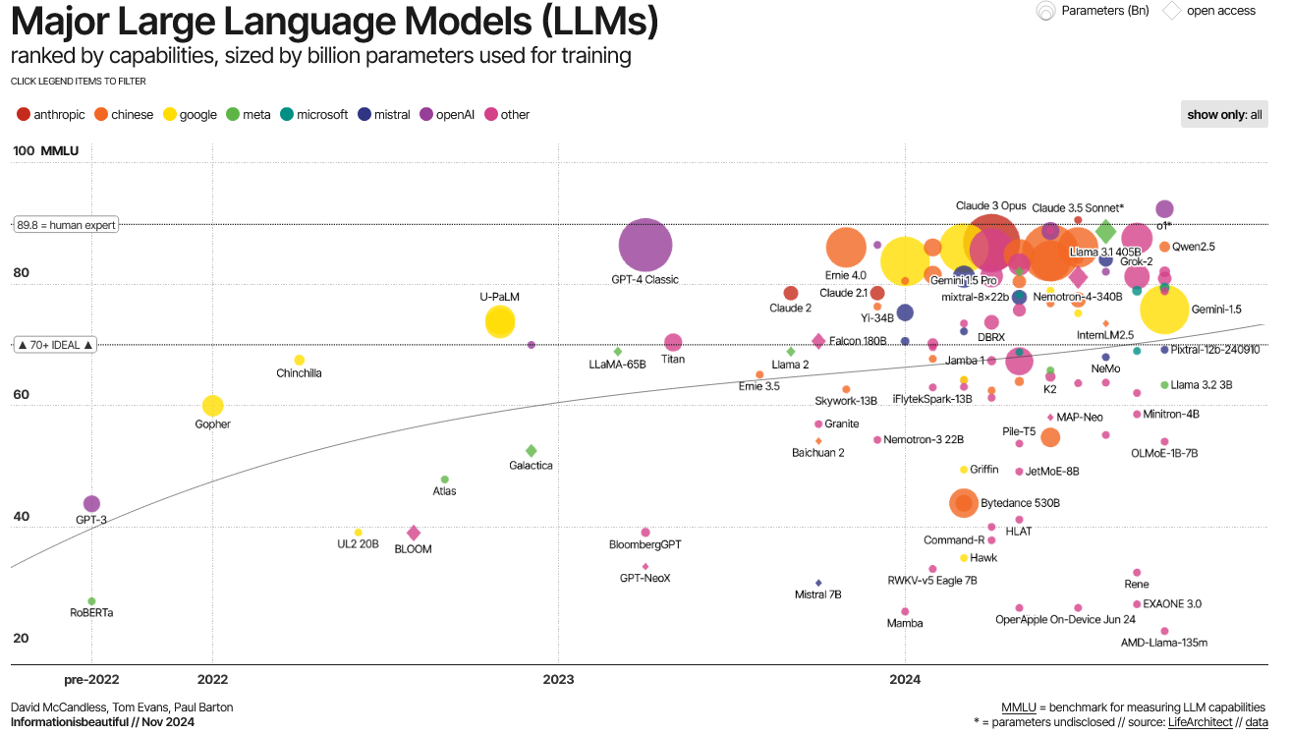
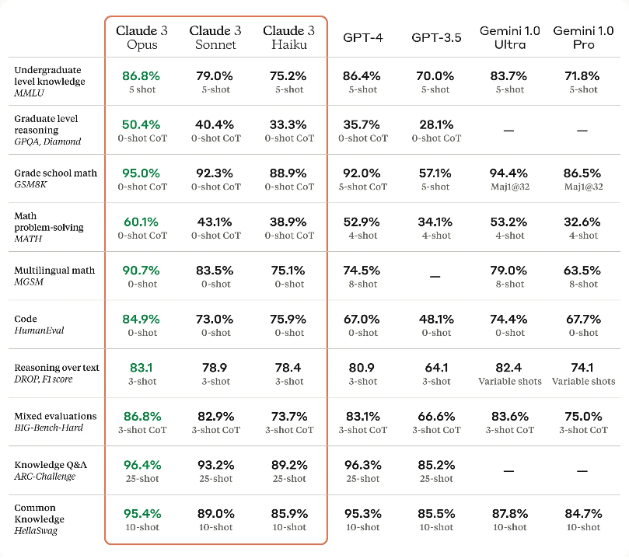
What do we know about AI Models?
Measuring Massive Multitask Language Understanding (MMLU)
OpenAI (2023) https://arxiv.org/abs/2303.08774
David McCandless, Tom Evans, Paul Barton Information is Beautiful // Nov 2024
Introducing the next generation of Claude, Mar 4, 2024

Slide 3
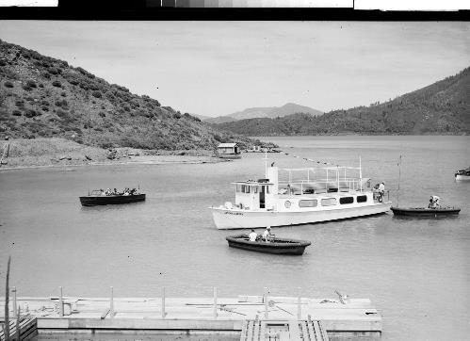
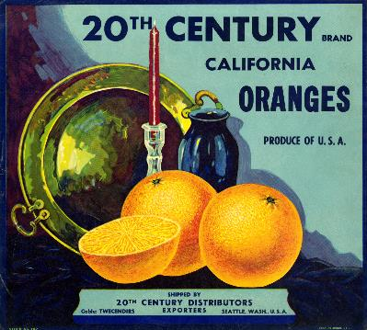
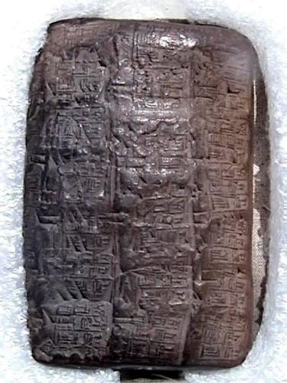
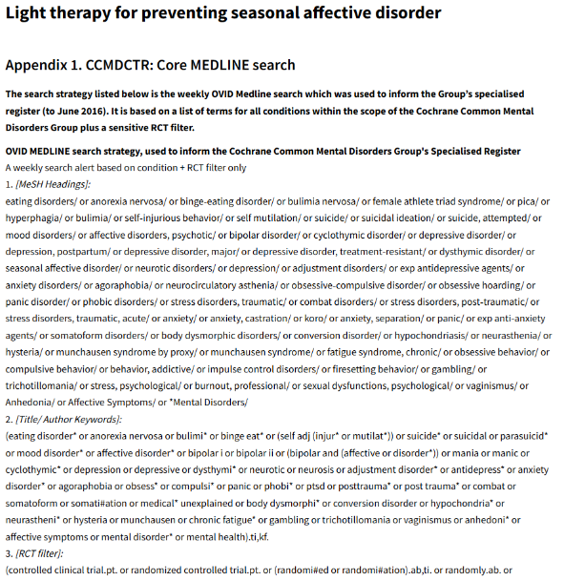
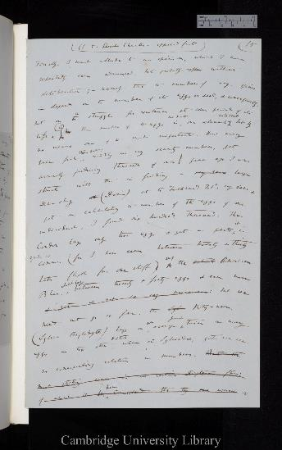
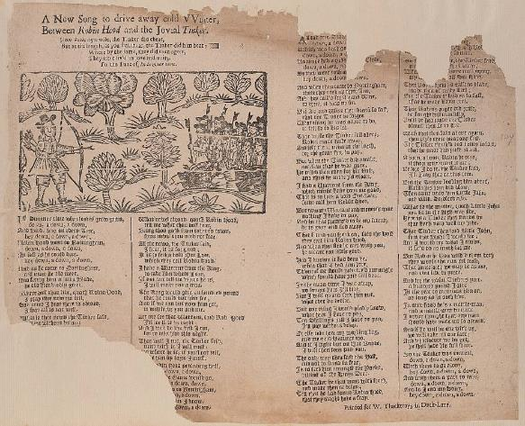
What does that mean for libraries?
https://digital.ucdavis.edu/collection/eastman/D-051/C-2/C-209
https://digital.ucdavis.edu/collection/lug_labels/D-211/D211_21_46
Shields Special Collections
General Collection ; PJ4071 .S9
Nussbaumer‐Streit B, Forneris CA, Morgan LC, Van Noord MG, Gaynes BN, Greenblatt A, Wipplinger J, Lux LJ, Winkler D, Gartlehner G. Light therapy for preventing seasonal affective disorder. Cochrane Database of Systematic Reviews 2019, Issue 3. Art. No.: CD011269. DOI: 10.1002/14651858.CD011269.pub3. Accessed 05 December 2024.
Darwin Online, Item ID CUL-DAR10.1.(1-78)
R235541, Beinecke Rare Book and Manuscript Library, 2000 Folio 6 308
https://ebba.english.ucsb.edu/ballad/35985/image

Slide 4
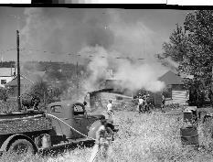
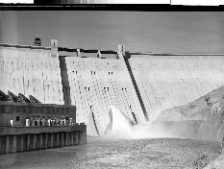
Image Captioning
Table of Contents recognition and extraction
Image-to-text model InstructBLIP using Vicuna-13b
98 black-and-white images
Scored x 2 against curator-generated description
82% correct
Less metadata than added by human curators
ToC identification scores
Gemini 1.0-vision-pro
N = 106
True positive=20 | False negative=0
False positive=3 | True negative=83
In the image, there is a black and white photograph of an old-fashioned fire truck spraying water to extinguish a fire.
Accuracy = (TP+TN)/everything = 103/106 = 0.972= 97%
Precision = TP / (TP+FP) = 20/23 = 0.87= 87%
Recall = TP / (TP +FN) = 20/20 = 100%
The image shows the Hoover Dam, which is a concrete arch-gravity dam in the Black Canyon of the Colorado River, located on the border between Nevada and Arizona in the United States.
Extraction to JSON scores
Correct language = 95%
Typo-free = 55%
Correct top level = 63%
Common errors
Combines two entries
Misses entries

Slide 5
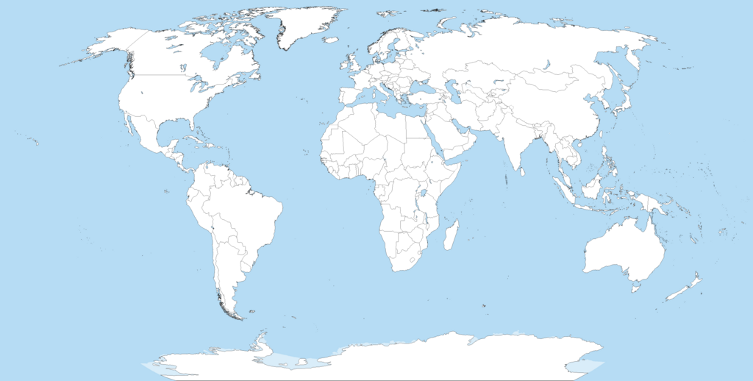
Vision
 | BW photo captioning | Medieval Manuscript transcription | Cuneiform translation | Literature retrieval
Model A | 98% | 15% | 5% | 15%
Model B | 5% | 4% | 78% | 5%
Model C | 50% | 35% | 0% | 90%
Model D | 95% | 89% | 3% | 35%
Model E | 45% | 65% | 4% | 10%
https://commons.wikimedia.org/wiki/File:A_large_blank_world_map_with_oceans_marked_in_blue.PNG
Creative Commons Attribution-Share Alike 2.5 Generic license

Slide 6
