Slide 1
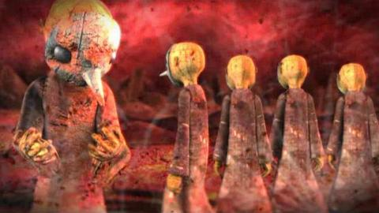
New Models of Content Creation and Scholarship in Spaces
New Models of Content Creation and Scholarship in Library Spaces
Mike Nutt and Greg Raschke
NCSU Libraries
CNI – December 2015
Notes:
Mike and I are going to give an overview of what is essentially a growing realization that academic and research libraries are facilitating and building -
New Models of Content Creation and Scholarship at the Intersection of Library Spaces, Technologies, and Expertise. That realization emanates in our context largely from opening of the James B. Hunt Jr. Library at the NCSU Libraries in January 2013.
URL(s) Associated With Your Project:
* http://www.lib.ncsu.edu/event/shooting-wars-documentary-images-american-military-conflicts
* http://www.lib.ncsu.edu/event/four-horsemen-apocalypse
The evolution of libraries working more broadly and deeply across the research life-cycle is undeniable – along with that the transformation of physical spaces and library environments to support scholars is also undeniable.
This is in fact a wonderful opportunity for libraries as they transform to provide not only knowledge services, but as a collaborative partner in the creation of information in many forms. Collaborative spaces, technologies, and expertise to support creation and ideation become catalysts for research productivity and learning.
One of the many issues associated with these transformations is the realization that we are collaborating with scholars to create new forms and sets of digital scholarship in these spaces. These spaces enable scholarship created within high-definition, large-scale visual collaborative environments. This emergent model of scholarly communication can be experienced within those specific contexts or through digital surrogates on the networked web. The realization that we are partners in the creation of new scholarship and the downstream implications of that realization create a robust and broad set of opportunities and challenges beyond the initial collaboration with the scholar in the space. Let me step back a bit before we dive into those.
From experiencing in three dimensions the sermons of John Donne in 1622 to interactive media interpretations of American wars , scholars are partnering with libraries to create immersive digital scholarship. Viewing the library as a research platform for these emergent forms of digital scholarship presents several opportunities and challenges. Opportunities include re-engaging faculty in the use of library space, integrating the full life-cycle of the research enterprise, and engaging broad communities in the changing nature of digitally-driven scholarship. Issues such as identifying and filtering collaborations, strategically managing staff resources, creating surrogates of immersive digital scholarship, and preserving this content for the future present an array of challenges for libraries that require coordination across organizations. From engaging and using high-technology spaces to documenting the data and digital objects created -- this developing scholarly communication medium brings to bear the multifaceted skills and organizational capabilities of libraries.

Slide 2
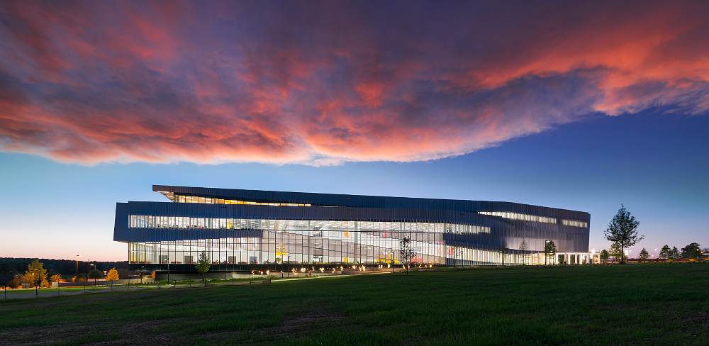
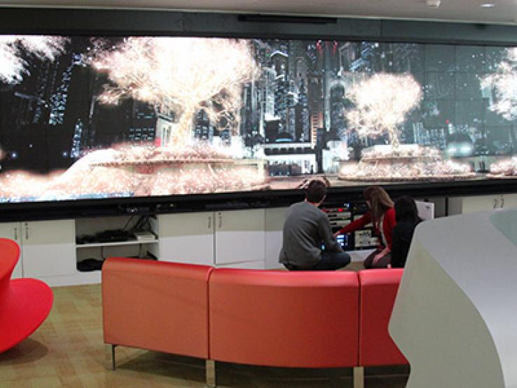
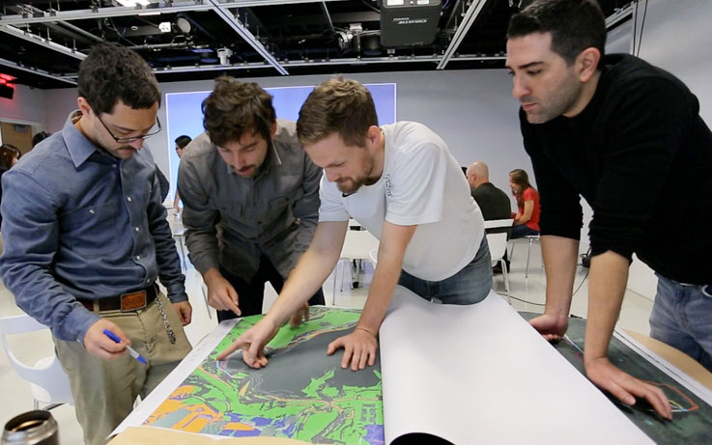
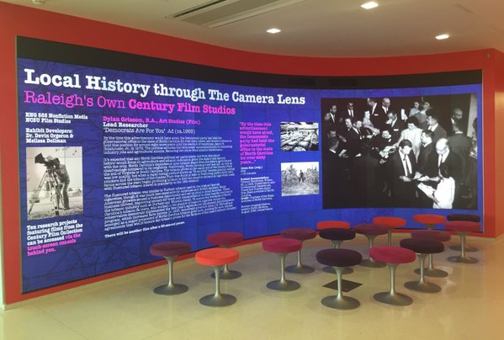
Broader Context
Notes:
The evolution of libraries working more broadly and deeply across the research life-cycle is undeniable – along with that the transformation of physical spaces and library environments to support scholars is also undeniable.
For us that evolution has been ongoing for many years, but the opening of the Hunt Library was a major evolutionary driver and milestone moment. It became a hugely tangible and significant investment in the digital research and scholarship (and pedagogy) of our faculty and advanced students.
Hunt Library Context.
The Hunt Library was planned and built with multiple high-technology, collaborative, large-scale visual environments for use in digital scholarship, interdisciplinary collaboration, and digitally-enhanced teaching.
Opportunities for re-engaging faculty in the use of library space, integrating the full life-cycle of the research enterprise, and engaging broad communities in the changing nature of digitally-driven scholarship.
Game Lab that includes a large (20.3x5 foot) interactive Christie® MicroTile® display, which can be used as a single panorama or divided into multiple sections.
Creativity Studio - a high-technology "white-box" space that can be configured for a wide variety of teaching, learning, and collaborative activities in many disciplines. It features high-definition projectors and movable and writable walls. The Studio can be configured for simulations and virtual environments.
Teaching & Visualization Lab - designed as a "black box" theater for high-definition visualization and simulation, offering 270-degree immersive projection on three walls for a total of 94 linear feet of display surface.
Also multiple public video walls - These displays make Hunt a storytelling building, integrating architecture and digital media to facilitate exciting new forms of communication.

Slide 3
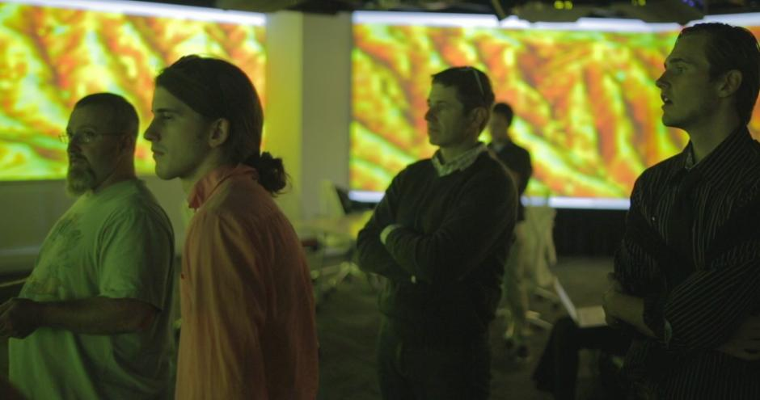
Project Incubation and Early Adoption
Notes:
Project Incubation and Early Adopters.
We knew these spaces could be powerful tools for teaching. We knew they would be powerful tools for visualizing research, unlocking data and the power of large-scale, high-definition display.
We knew these would be excellent forums for public engagement, testing of visualization and display in public environments, and conveying scholarship to public audiences.
We worked with some early partners in our Digital Games Research Center, Computer Science, Digital Media programs, etc. We knew these early adopters willing to test, iterate, ideate, fail, try again, and help us build were critical to success and getting future adopters and users.
What we did not anticipate as well is the extent to which these spaces would be used to create new scholarly content - new forms of digital scholarship created specifically to be experienced within those spaces.
I think libraries with these types of spaces are creating emergent models of scholarly communication – which brings with it many of the opportunities, questions, roles, and responsibilities associated with more traditional forms of scholarly communication.
3

Slide 4
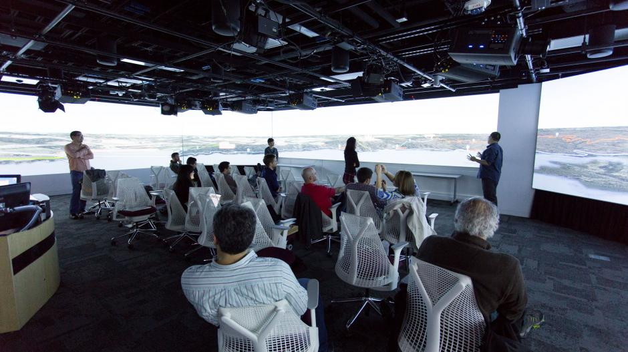
Realization
“The most important factor to the design of the Hunt Library as a research component at NCSU is the new relationship between the library and the faculty member.” – Michael Young, Computer Science, NC State.
Notes:
Eventual Realization.
Library spaces that blend collaboration areas, advanced technologies, and librarian expertise are creating new modes of scholarly communication and new relationships between libraries/librarians and faculty.
These spaces enable scholarship created within high-definition, large-scale visual collaborative environments. This emergent model of scholarly communication can be experienced within those specific contexts or through digital surrogates on the networked web.
These new emergent forms of scholarly communication create the kinds of opportunities I have touched on previously - to recast the physical library, to transform the relationship of the library with its researchers (Michael Young quote), to foster creative forms of digitally-centered scholarship, to promote cross-disciplinary work, to re-case the role and skills of librarian collaborators, and to use these spaces as gateways to additional library services and collaborations.
Diffusion.
Also present significant challenges:
Staff resources.
Project selection and management.
Experiencing created works outside of specific space and time - e.g. creating surrogates of immersive digital scholarship.
Reviewing and credentialing.
Preserving.
More broadly for faculty the incentive and reward infrastructure for these projects is uncertain – particularly across institutions.
Absolute no-brainer to build these kinds of spaces and engage scholars in this way.
Figuring out some of these challenges – scaling this type of engagement, creating derivative assets for the web, working with the university to address issues such as review and rewards/incentives, and working with funding agencies to conceptualize and understand this type of scholarship is going to be essential as libraries continue to build and evolve these types of spaces. Our experience has borne out the vast opportunities associated with building such spaces along with the challenges with which we need to wrestle to expand their impact. 2.5 years in and still figuring out how to approach these creative collaborations – having fun doing it.
4

Slide 5
Examples
Notes:
I’m Mike Nutt, the Director of Visualization Services in our Digital Library Initiatives department. I’d like to describe a few of the projects we’ve done that illustrate how we’re pushing the boundaries of scholarly communication. Each of these represent different approaches to engagement with faculty and students in our spaces.
5

Slide 6
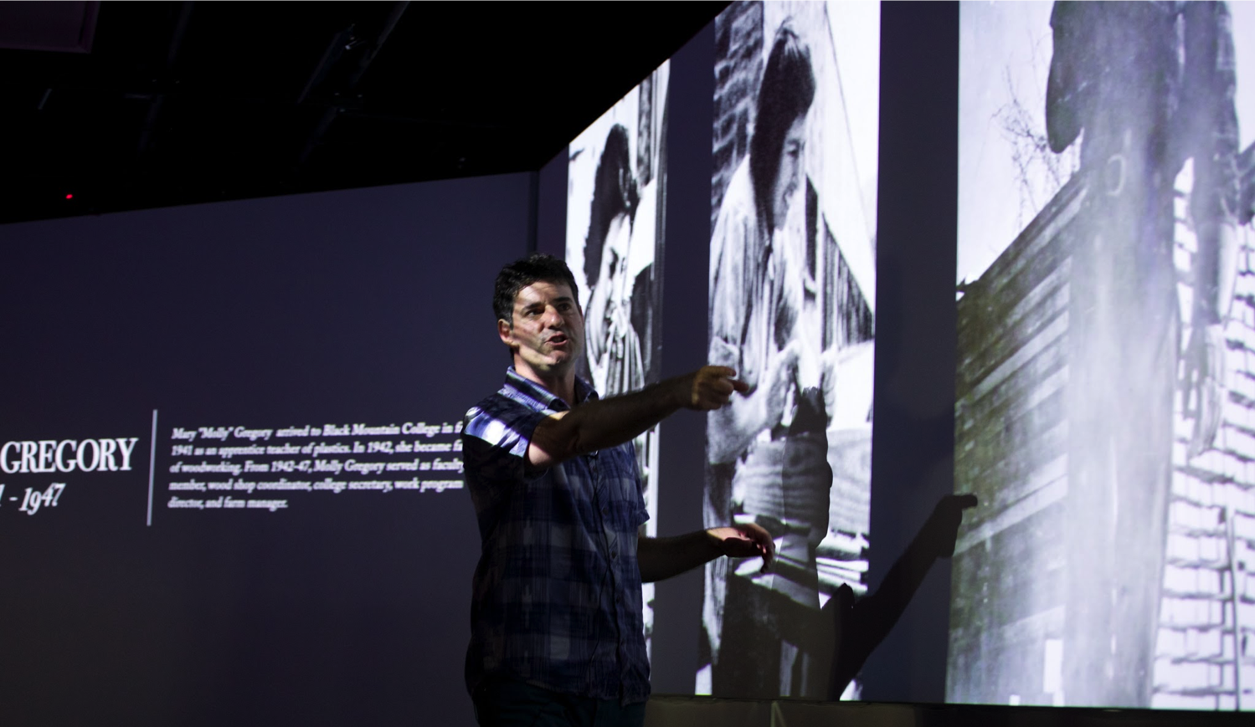
Visiting Scholar: A Happening
go.ncsu.edu/bmc
Notes:
I’ll start with a project I worked on that epitomizes this idea. We’ve hosted University of San Francisco Professor David Silver for each of the last two summers as a Visiting Scholar. He’s an Associate professor of media studies and environmental studies. David really pushed the idea of a lecture into new territory with his work with us. I’ll explain more about what we did in a second, but just to quickly give you a little background: His research focuses on the Black Mountain College, which was a fascinating and influential arts school that was founded in 1933 and existed for 23 years. Faculty included famous artists, poets, and designers like Bucky Fuller, Josef Albers, Charles Olson, and Willem de Kooning. It was highly experimental: no grades, no majors, no sports, no Chancellors or provosts, and often no money for salaries.
In each of his residencies, he worked with us over the course of a couple weeks. We staged what we called “happenings” that described the history of the College by moving through the building and using our different visualization spaces to tell different parts of the Black Mountain College story. We thought of these wandering lectures as an homage to the very first happenings that were staged at Black Mountain College by John Cage and Merce Cunningham.
So I’m going to let David speak for himself here and play a video clip that reinforces what Greg was saying about librarian expertise playing a role in this project. It will also give you a sense of how we moved through the building.

Slide 7
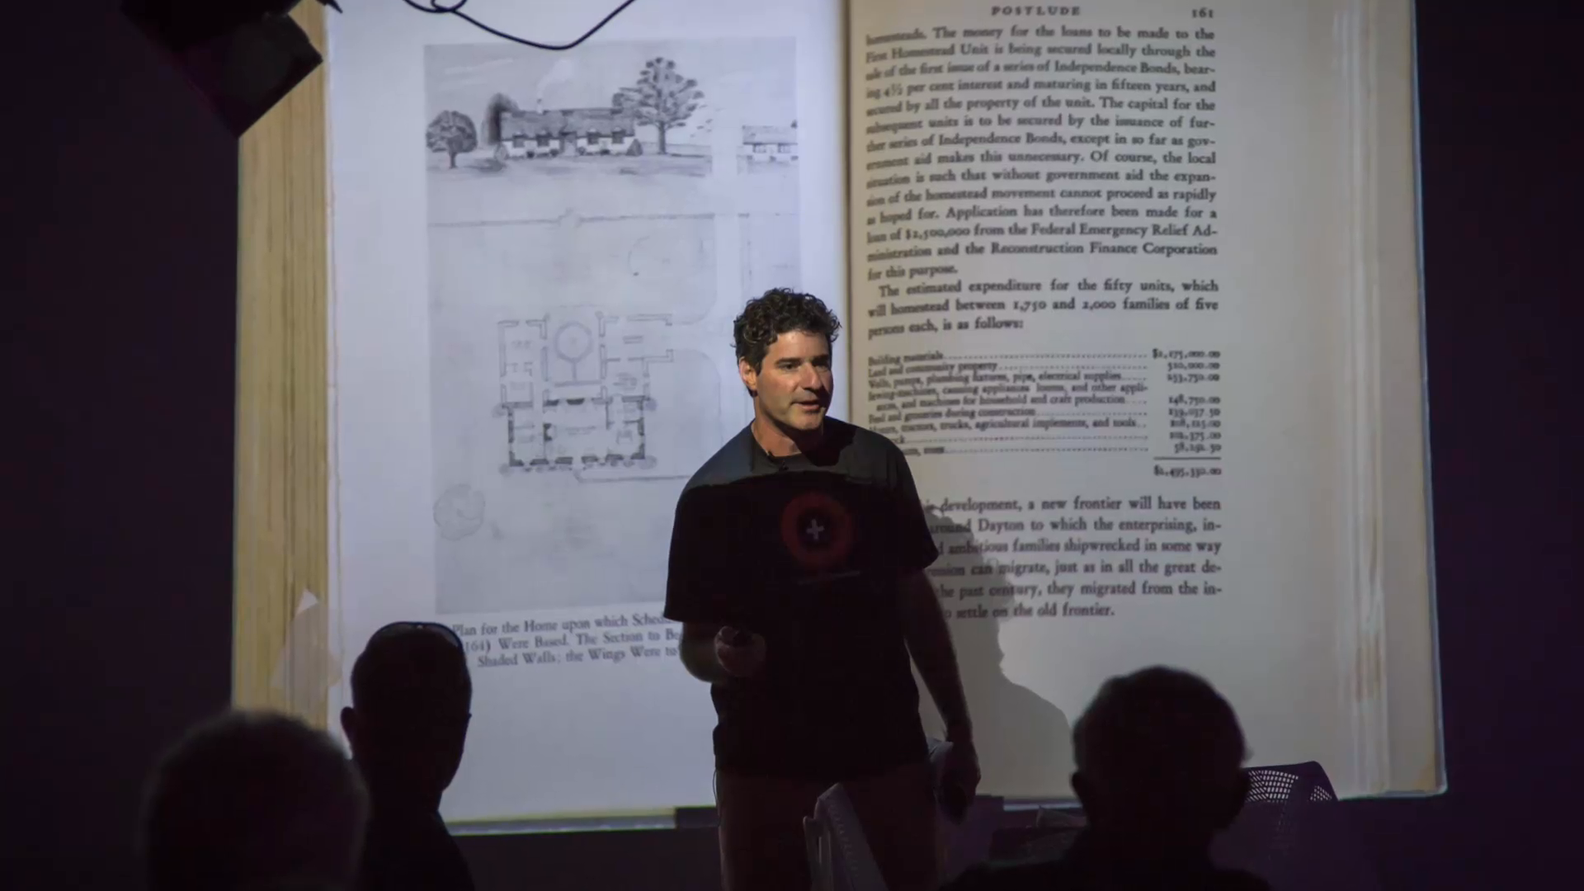
Visiting Scholar: A Happening
Notes:
So as you can see this physically involved the audience by moving around the library, presenting different chapters of the story in different spaces around the building.
It’s worth noting that hosting a visiting scholar gave us a great excuse to engage our local faculty in a conversation about how to use our spaces. David actually invited some of our digital humanities faculty to come critique a first draft of his presentation and that inter-institutional dialog was really valuable for everyone involved.

Slide 8
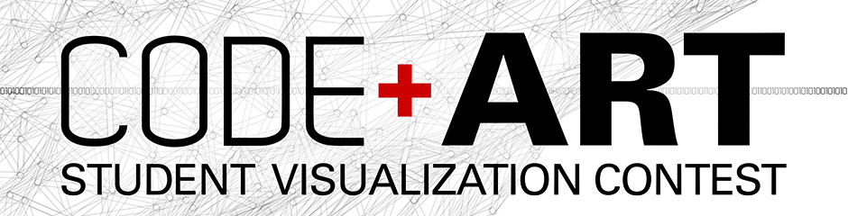
Code+Art: Interdisciplinary Connections
lib.ncsu.edu/codeart
Notes:
One project I’m really excited about is our Code+Art program, which we developed to encourage students to create software-driven generative art for our video walls. We’ve had one successful year of our Code+Art program and are in the middle of our second year, thanks to Christie who has been the primary sponsor of this student visualization contest. Code+Art hits an important strategic target for us because it curates dynamic content that can fill large amounts of screen time with cutting edge, software-driven, interdisciplinary art that combines computational thinking and design thinking. For a library this kind of content actually makes a lot of sense because it’s about new ways to perceive and experience large amounts of data.
8

Slide 9
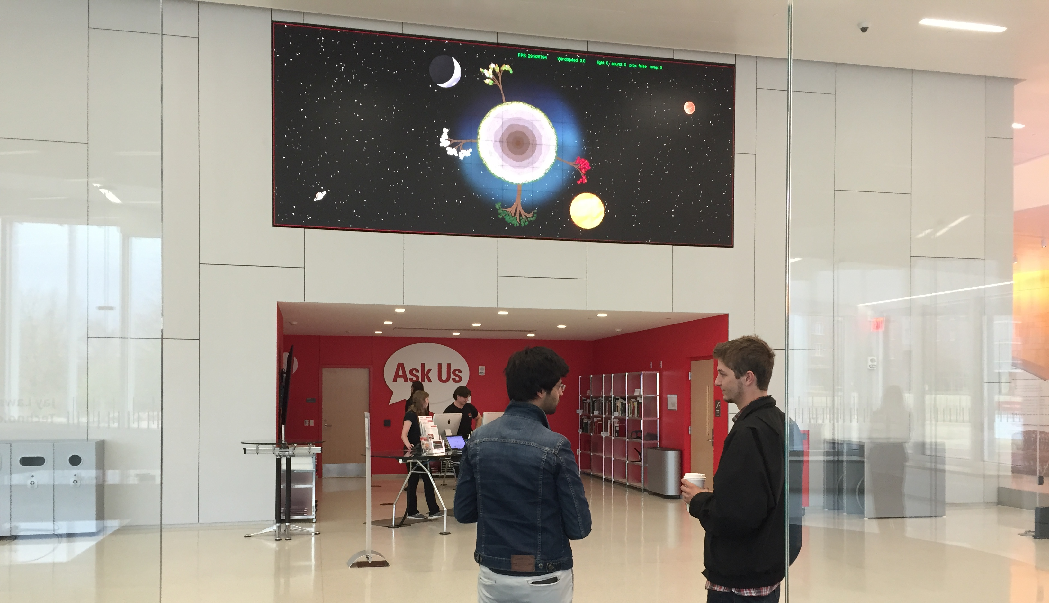
Code+Art: Interdisciplinary Connections
Notes:
This is a picture of the winning team from last year working on their project called Fractal Forrest, which is a Processing application that we still have in heavy rotation. I love this picture because it shows a computer science student and a design student working on a piece of digital art in the Hunt Library, who wouldn’t have ever met each other if it weren’t for the Code+Art contest. So in this case we’re using a contest as a model for classroom and student engagement, and providing a unique space (physical and metaphorical) on campus for the interdisciplinary intersection of design & data.
9

Slide 10
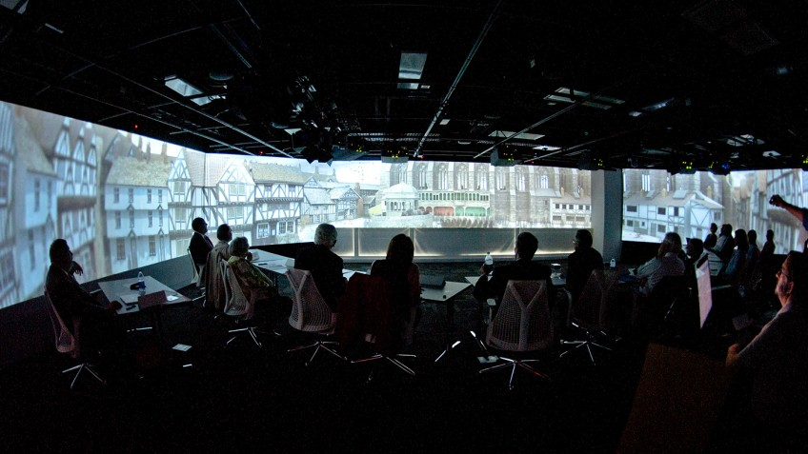
Virtual Paul’s Cross
Notes:
One last project, which is an example of a sponsored research collaboration, the Virtual Paul’s Cross Project. An architecture and English professor worked together to recreate the delivery of John Donne’s sermon for Gunpowder Day, November 5, 1622 in our Teaching and Visualization Lab. They used acoustical modeling of a space that had to be recreated virtually through archival research because it doesn’t exist anymore, it burned down. So rather than only reading the text of Donne, students can experience his words as they would have in the 17th century.
This was one of our early collaborations in the Hunt Library, so I want to give you an update in case you’ve heard of this project already. The National Endowment for the Humanities recently awarded this team its largest grant ever on the merits of the work that we did together. Considering that NC State is primarily a STEM school, that grant really speaks to the ability of these spaces to provide a competitive advantage to our humanities researchers and help them stand out in the field.
10

Slide 11
Challenges
Notes:
As Greg mentioned, these kinds of projects are not without their challenges, so I’m going to briefly expand on some of those.
11

Slide 12
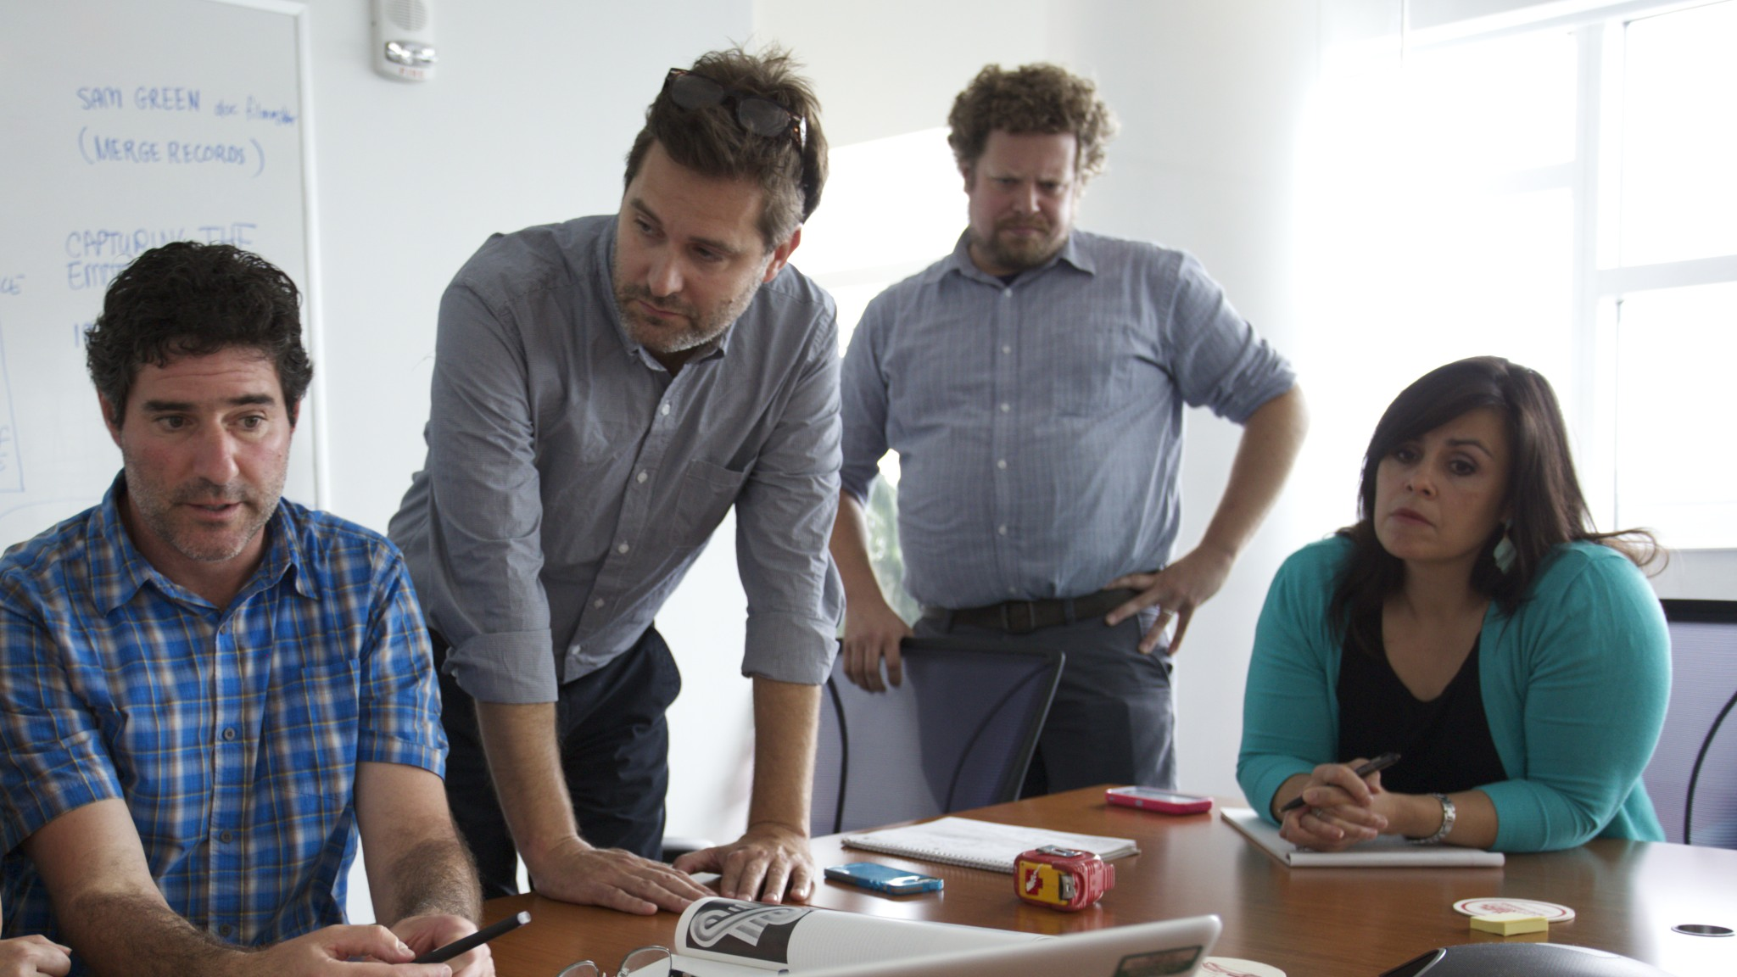
Strategically Managing Staff Resources
Notes:
Expertise, of course, is a human resource. And if your scholarly output is an interactive, multimodal, digitally humanistic happening in a library, all those skills are probably not going to reside in a single human being. This picture of a planning meeting with David shows our Director of Publications, our digital media librarian, and our director of program planning and events, and that was about half the people in the room. So it takes a fair amount of talented librarians to create an amazing project like David’s.
And amazing projects require good project management. In the case of David’s events, there was a dedicated project manager (me). And finally, this all had to happen while we were managing our existing daily responsibilities. The world doesn’t stop when you host a visiting scholar, and it can be difficult to clear your calendar.
This is a very different model of service than say, putting your course materials on reserve. There’s a question of scale here. We have something like 2300 faculty. Could we do something like this with each one of them? Obviously the answer is no, there aren’t even enough hours in the day to do that, even if we had the staff resources.
So the question becomes, how do you turn collaboration into a service? How do you decide which projects to devote resources to and how do you make that process transparent to faculty?
12

Slide 13
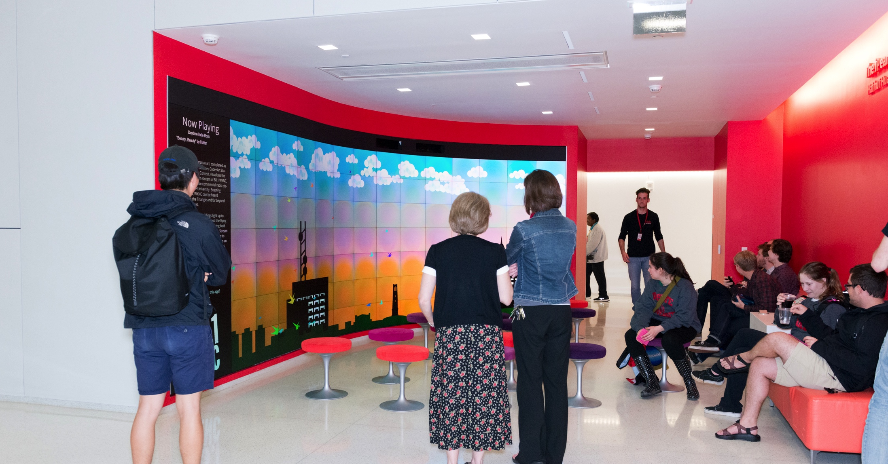
Is it a “publication”?
Notes:
The truth is that, right now, not all 2300 of those faculty want to collaborate with us in that way, because not all of them are incentivized to do that. Professors might say, sure, I’d like to use these spaces to do something new, but would I get “credit” for it? Are these projects treated as a kind of publication? Are they going to make it into the tenure portfolio of a professor or onto her CV? The answer to that depends somewhat on the discipline and on departmental policies or on the individual. But one thing I’d really like to see us work on is finding or establishing a network that could provide a peer review mechanism for experiential scholarly communication. The methods for that kind of evaluation exist, I think, but I’m not sure the platform for it does yet. I’d love to be corrected if I’m wrong! However, I do want to point out the fact that what you see here is the other winning student piece from last year’s Code+Art contest. For students, what constitutes a “publication” is very different. For the Code+Art winners, their installations are going to go on their resumes and in their job portfolios, and help get them jobs. For me, being a part of that student success is one of the main reasons I’m a librarian.
13

Slide 14
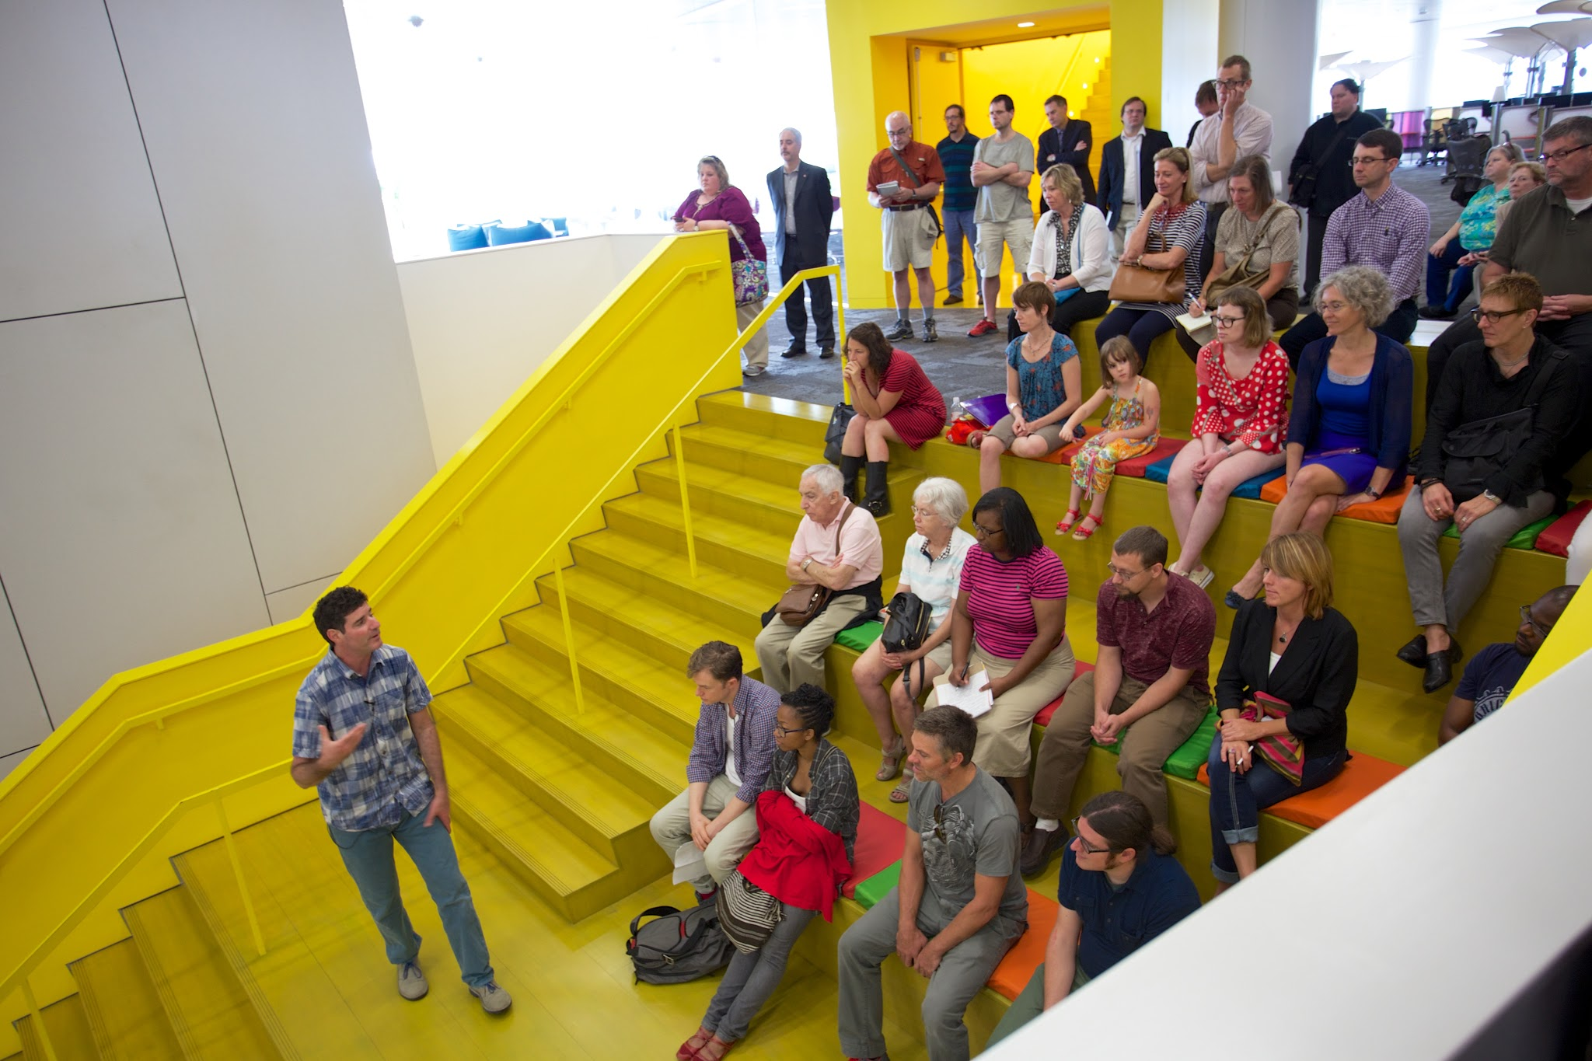
Reproduction
Notes:
When was the last time you went to an academic lecture and then later, when you were talking about it to someone else, said, “I can’t explain it, you just had to be there.”? I found myself wanting to say that about our work with David, and then I realized that was really problematic! He was challenging foundational myths about the most important art school in America. Isn’t that knowledge that we want to disseminate far and wide and not just to the people who were lucky enough to be within driving distance? So we have a real challenge in conveying this scholarly experience to people outside of the physical spaces in which they occurred. In fact the ideal is to produce scholarly output that has the intimacy of a face-to-face gathering like this but also allows us to reach web scale.
14

Slide 15
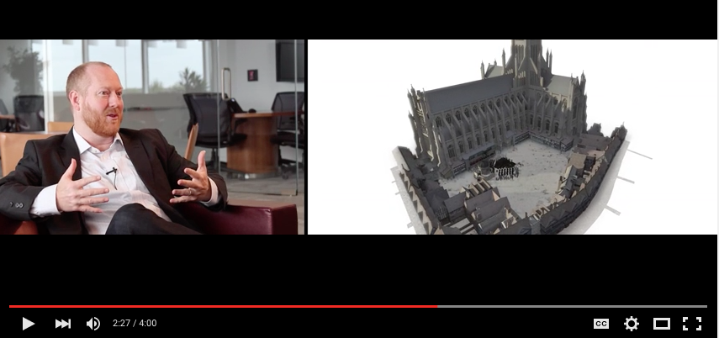
Dissemination
Notes:
So until real-time virtual reality becomes widespread, we may have to depend on the creation of surrogates to experience the content outside of the spaces for which it was intended. For the Virtual Paul’s Cross Project, I helped create a mini-documentary about the piece where the PIs for the project discuss their methodologies and what went into the creation of the project. This four minute video is on YouTube and allows people to get a sense of the scholarship behind the piece. In fact it often is played in conjunction with demos of the piece in our teaching and visualization lab, but it is still only a surrogate for the actual experience. And the creation of the surrogate itself was time and resource intensive so surrogate creation has to be part of the project planning from the beginning.
15

Slide 16
New Models of Content Creation and Scholarship in Spaces
New Models of Content Creation and Scholarship in Library Spaces
Mike Nutt and Greg Raschke
NCSU Libraries
CNI – December 2015
Notes:
Thanks for your time. We’d love to take your questions and hear more about what you’re doing at your libraries.

